Slide 1
Employee Data Analysis using Excel
STUDENT NAME: G SANTHIYA
REGISTER NO: 312216346
DEPARTMENT: III B.Com (GEN)&6FBA119B61A0C3D8BEE42C424A0CDEC3
COLLEGE: Shri Shankarlal Sundarbai Shasun Jain College for Women.

Slide 2
PROJECT TITLE
Employee Performance Analysis using Excel

Slide 3


AGENDA
Problem Statement
Project Overview
End Users
Our Solution and Proposition
Dataset Description
Modelling Approach
Results and Discussion
Conclusion
3/21/2024 Annual Review

Slide 4

PROBLEM STATEMENT
In today's competitive business environment, organizations are constantly striving to maximize productivity and improve employee performance. To achieve this, it is crucial for managers and hr departments to have a clear understanding of the performance metrics of their employees. However, managing and analyzing large amounts of performance data can be challenging without the right tools.

Slide 5

PROJECT OVERVIEW
Greater transparency in performance evaluation processes, leading to more motivated and engaged employees. By leveraging Excel's capabilities for data analysis and visualization, this project aims to provide a scalable and cost- effective solution for employee performance management, supporting organizational goals and fostering a culture of continuous improvement.

Slide 6

WHO ARE THE END USERS?
Human Resources (HR) Departments
Managers and Supervisors
Executives and Senior Management
Employees
Training and Development Teams
6 .Compensation and Benefits Teams
7. Consultants and Analysts

Slide 7

OUR SOLUTION AND ITS VALUE PROPOSITION
Your solution leverages Excel to provide a comprehensive, user-friendly, and cost-effective approach to employee performance analysis.
VALUE PROPOSITION:
Cost-Efifiectiveness
Ease ofi Use
Data Management
Customizable Analysis
Real-Time Analysis

Slide 8
Dataset Description
*Employee data set taken from kaggle.
*Out of 26 features, 9 were selected.
LISTED FEATURES:
Employee ID
First name
Last name
Business unit
Employee Type
Employee Status
Employee classification type
Gender Code
Performance Score
Current employee rating

Slide 9

THE "WOW" IN OUR SOLUTION
Interactive Dashboards
Data Visualization
Automated Reporting
Predictive Analysis
Scorecards and Balanced Scorecards
Employee Ranking and Comparison
Training and Development Analysis
Employee Feedback and Sentiment Anlysis
KPI Tracking with Alerts
Data Security and Privacy
3/21/2024 Annual Review
9

Slide 10
MODELLING
DATA COLLECTION:
Data sourced from Edunet dashboard.
FEATURE COLLECTION:
The listed 10 features selected for analysis.
DATA CLEANING:
Handling missing values.
CALCULATION OF PERFORMANCE LEVEL:
Using employee rating to determine performance.
SUMMARY OF PIVOT LEVEL:
Organizing data using pivot tables.
VISUALIZATION:
Graphical representation using pivot tables.

Slide 11

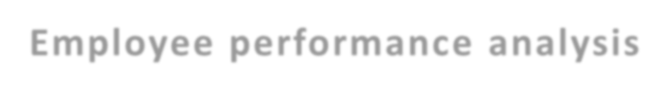
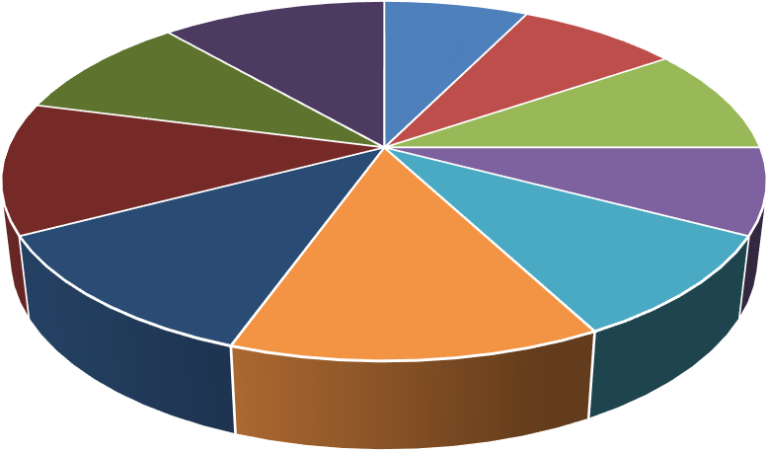
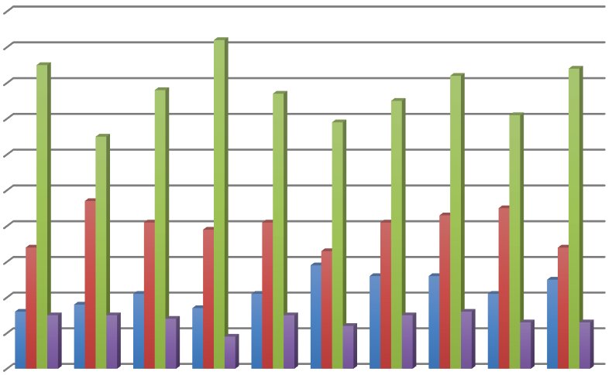
RESULTS
=IFS(Z6>=5,"VERY HIGH",Z6>=Z6>=3,"MED",TRUE,"LOW")
HIGH
Employee performance analysis
100
90
80
70
60
BPC
CCDR
EW MSC NEL PL PYZ
HIGH
50
40
30
20
10
0
LOW MED
VERY HIGH
SVG
TNS
WBL
BPC CCDR EW MSC NEL
PL
PYZ SVG TNS WBL

Slide 12
Conclusion
The employee data analysis conducted using Excel has provided valuable insights into
workforce performance and trends within the organization. By systematically collecting, cleaning, and analyzing key employee data, we have been able to:
Identify Performance Trends
Highlight Key Metrics
Utilize Advanced Excel Tools

